Slide 1


Designing of methodologies and indicators for monitoring and evaluation process of implementation of Bologna process at Serbian universities
Stefan Dujović, Andreja Dinić, Igor Graić
University of Novi Sad, Novi Sad, Serbia

Slide 2
Pilot activity.
In order to precisely calculate student workload.
Based on filling the diaries that we developed.

Slide 3
Cooperation with State University of Novi Pazar
80 work diaries (40 UNS and 40 SUNP):
    Tehnical-tehnological field
    Social-humanity field
    Scientific field
    Medical field

Slide 4
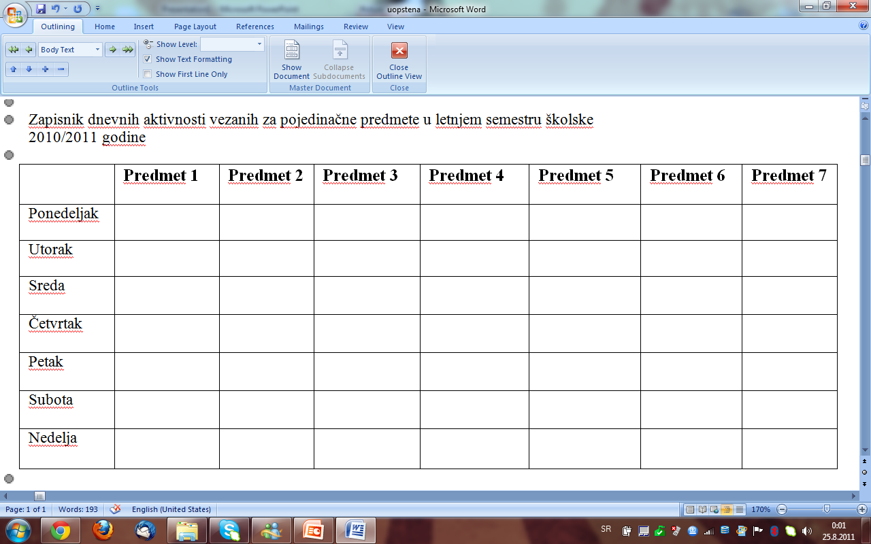

Slide 5
Disadvantages:
-Field for subject ECTS
-Field for number of classes

Slide 6
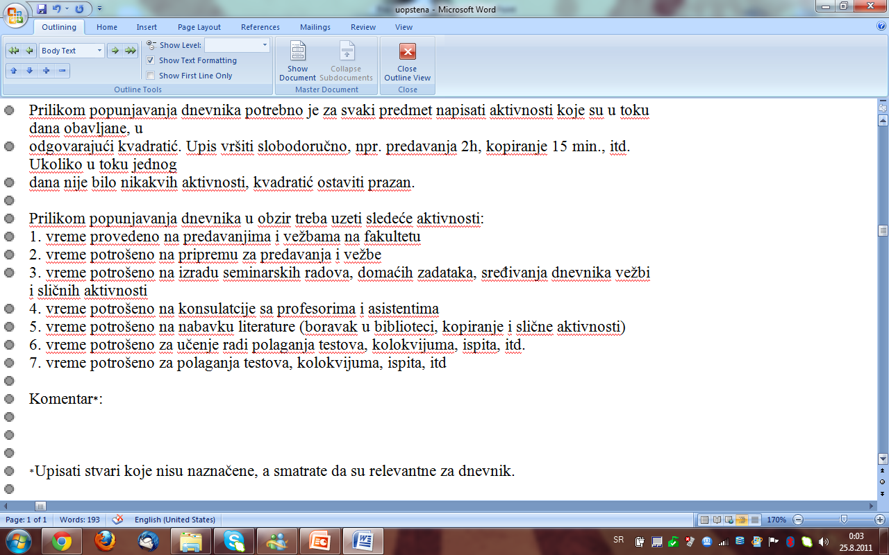

Slide 7
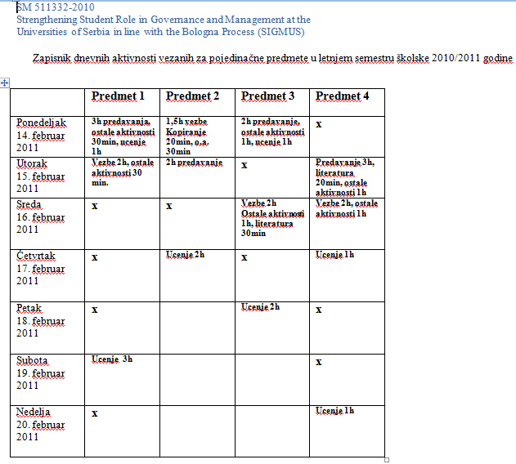

Slide 8
Problems with finding students who will complete the diaries to the end.
80 diaries were shared, only 10 were collected.
So, in order to have representative sample, we must share at least 60 diaries per subject.

Slide 9
Student are not very intrested in taking a part in this project and running their diaries, so we have to find some way to motivate them and include as many as possible.

Slide 10
For the end:
Students workload on our Universities is not well calculated, so WE as the highest students representatives should support this activity of SIGMUS and help our students in Serbia, after all that is our job.

Slide 11
Thank you for your attention!

